Slide 1
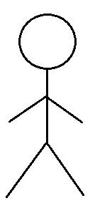
Team 2 - Sequence Diagram - 01. Home Page - Use Case 1.1 Register new Customer user
:Customer
Guest User
createUser()
sendCredentials()
201 User Created
register()

Slide 2
Team 2 - Sequence Diagram - 01. Home Page - Use Case 1.3 User Login
:Customer
Guest User
authenticate()
sendCredentials()
200 Login Success
login()

Slide 3
Team 2 - Sequence Diagram - 02. Menu - Use Case 2.1. View Menu
:Menu
Guest User
getItems()
View Menu

Slide 4
Team 2 - Sequence Diagram - 02. Menu - Use Case 2.2. Choose Menu Item
:Menu
:Item
User
getItems()
View Menu
getItemById()
View Item

Slide 5
Team 2 - Sequence Diagram - 02. Menu - Use Case 2.4. Order Placed
:Menu
:Item
:Order
User
Search food getItems()
View Menu
getItemById()
Add food
View Item
addItem()
Add Item to Order
Show items
createOrder()
Order placed

